Slide 1
Heat Exchanger for Solid Oxide Fuel Cell Vehicles
Chase Ambeau, Jameson Bonnett, Mike Bos, Ian Censner, Orion Miller

Slide 2
Introduction

Slide 3
sfbvxcb
cbx

Slide 4
Design Decisions

Slide 5
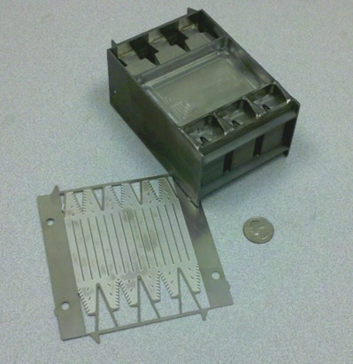
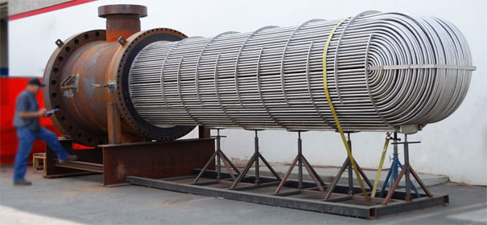
Types
What is a micro-tube heat exchanger?
Why wont other types work?

Slide 6
System Layout
What

Slide 7
Material Selection
Considerations included:
Melting Temperature
Thermal conductivity
Corrosion resistance
Material | Melt Temp. | k-Value
Nickel | 1726 K | 90 W/m.K
Steel | 1643 K | 40 W/m.K
Titanium | 1941 K | 23 W/m.K

Slide 8
Calculations

Slide 9
sfbvxcb
cbx

Slide 10
Flow Analysis

Slide 11
sfbvxcb
cbx

Slide 12
Results

Slide 13
sfbvxcb
cbx

